Slide 1
Project – Contact Management App

Slide 2
ContactController Class
public with sharing class contactcontroller {
@AuraEnabled
public static list<contact> searchcontacts(){
return[Select Id, Name, Phone from Contact Limit 30];
}
@AuraEnabled
public static list<contact> searchbyquery(string searchquery){
string name = '%'+searchquery+'%';
return[Select Id, Name,Phone from Contact Where name LIKE:name LIMIT 30];
}
@AuraEnabled
public static contact findbyid(string contactId){
return[select Id, Name, phone, mobilephone,title, Account.Name from Contact Where Id=:contactId];
}
}

Slide 3
ContactList Component
<aura:component controller="contactcontroller">
<aura:attribute name="contacts" type="contact[]"/>
<aura:handler name="init" value="{!this}" action="{!c.doInit}" />
<ul class="list-group">
<aura:iteration items="{!v.contacts}" var="contact">
<li class ="list-group-item">
<a href = "{!'#contact/'+contact.Id}">
<p>{contact.Name}</p>
<p>{!contact.Phone}</p>
</a>
</li>
</aura:iteration>
</ul>
</aura:component>

Slide 4
ContactList Controller
({
doInit : function(component, event) {
var act = component.get("c.searchcontacts");
act.setCallback(this,function(a){
component.set("v.contacts", a.getReturnValue());
});
$A.enqueueAction(act);
}
})

Slide 5
ContactDetails Component
<aura:component controller="contactcontroller">
<aura:attribute name="contact" type="contact" default="{'sobjectType':'Contact'}"/>
<aura:handler event="aura:locationChange" action="{!c.locationchange}"/>
<div class = "details">
<h1>{!v.contact.Name}</h1>
<h3>{!v.contact.Account.Name}</h3>
<h3>{!v.contact.Title}</h3>
<h3>{!v.contact.Phone}</h3>
</div>
</aura:component>

Slide 6
ContactDetails Controller
({
locationchange : function(component, event, helper) {
var token = event.getParams("token");
if(token.indexOf('contact/')===0){
var contactId = token.substring(token.indexOf('/')+1);
var action = component.get("c.findbyid");
action.setParams({"contactId":contactId});
action.setCallback(this,function(a){
component.set("v.contact",a.getReturnValue());
});
$A.enqueueAction(action);
}
}
})

Slide 7
Lightning Application
<aura:application >
<link href='/resource/Bootstrap/' rel ="stylesheet" />
<div class="navbar navbar-default navbar-static-top" role="navigation">
<div class ="container">
<div class="navbar-header">
<a href="#" class="navbar-brand"> Lightning Contacts </a>
</div>
</div>
</div>
<div class="container">
<div class ="row">
<div class="col-sm-12">
Contact List
<c:contactlist/>
</div>
</div>
</div>
</aura:application>

Slide 8
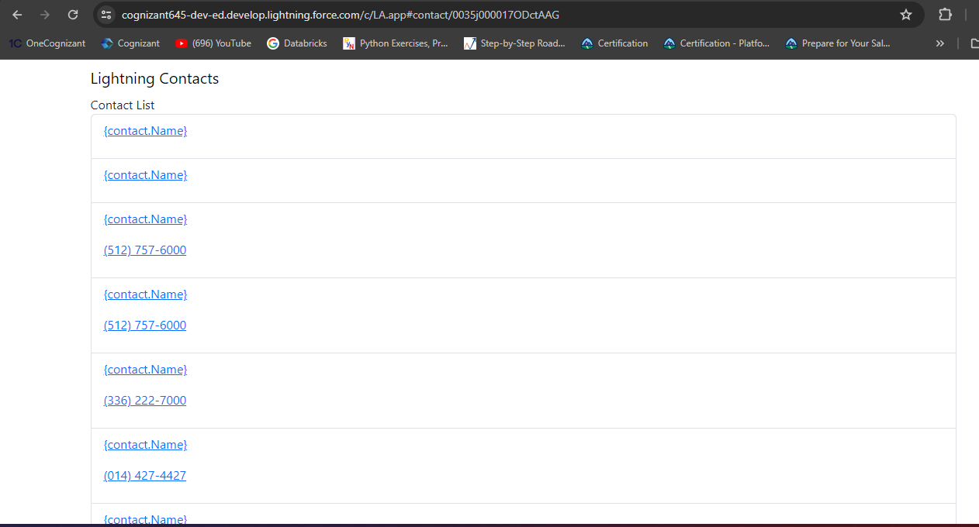
Web Page

